Slide 1
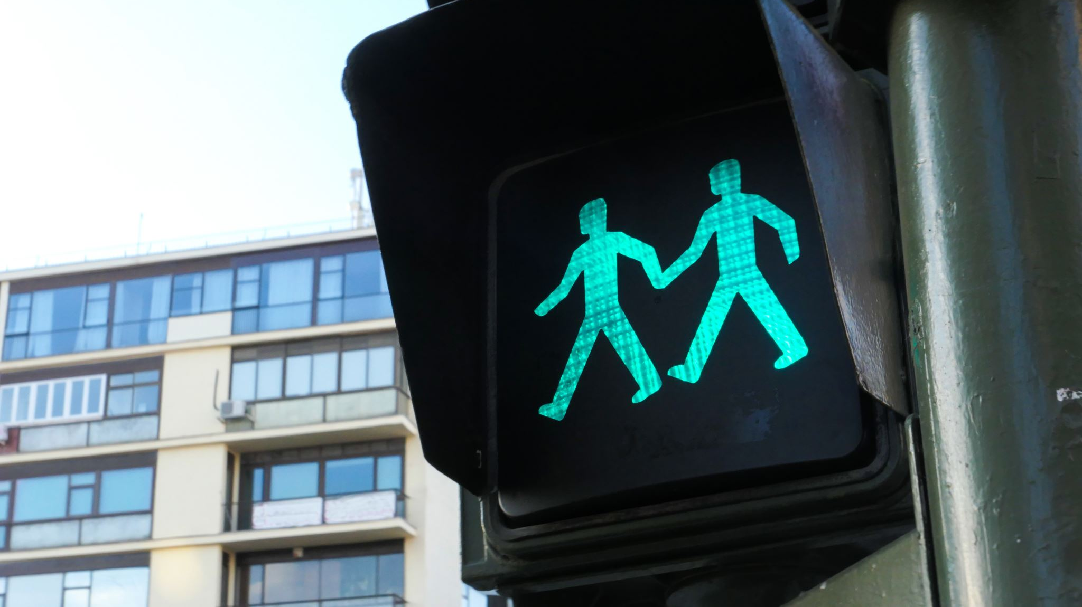
Traffic Sign Recognition
Group Members
Jumana Lightwala: C0892358
Niral Shah: C0894470
Shivamkumar Patel: C0907758
Shreyash Banawala: C0891309

Slide 2
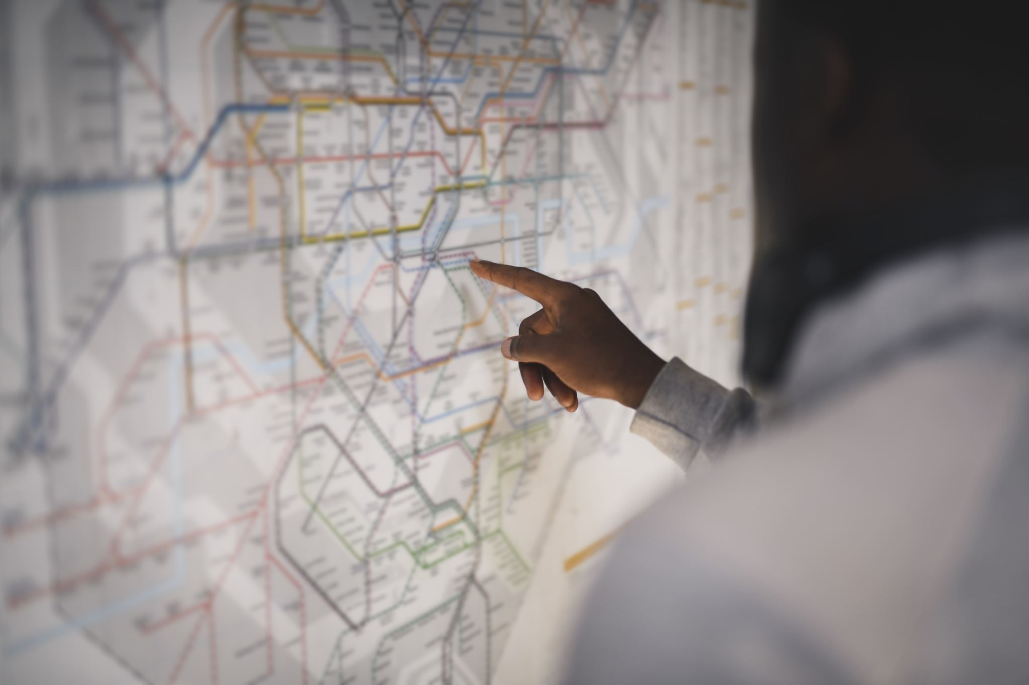
Introduction
Greetings and welcome to the Traffic Sign Recognition Web App project introduction. In this session, we'll explore an intriguing application that uses cutting-edge technology to transform how we recognize and classify traffic signs.
By developing a robust model capable of accurately detecting various types of traffic signs, we seek to mitigate risks on roads and improve traffic management systems.
This project holds significant potential to revolutionize transportation by providing advanced solutions for real-time sign recognition and autonomous vehicle navigation.

Slide 3
Waterfall Methodology
The waterfall methodology is used in our Traffic Sign Detection System project, which breaks work into phases such as requirements, design, implementation, testing, deployment, and maintenance. We effectively manage resources when we have well-defined goals in advance.
The waterfall approach offers a strong foundation for our CNN-based solution by emphasising planning and progressive development.
02
03
04
01
05
System Design
Implementation
Testing
Requirements Gathering
Deployment and
Maintenance

Slide 4
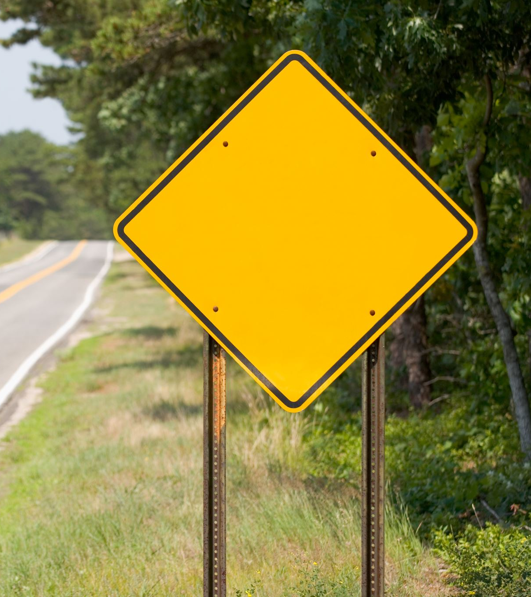
Key Points:
Recognition of Traffic Signs: Traffic signs are essential for maintaining road safety and traffic control. On the other hand, manual recognition can be laborious and error-prone.
Automated Solution: To meet this difficulty, our research creates an automated solution that uses machine learning methods to identify traffic sign labels from pictures.
Practical Importance: Correct identification of traffic signs leads to safer roadways, fewer collisions, and an improved driving experience.

Slide 5



Problem Statement
Manual Recognition Challenges: Recognising traffic signs manually requires specialised expertise, is subject to human mistake, and is affected by changing lighting.
Time Consumption: Identifying signs manually can be time-consuming, leading to potential delays and inefficient decision-making on the road.
Automated Efficiency: Real-time recognition skills, accuracy, and efficiency can all be improved with an automated system that uses machine learning.

Slide 6

Solution Overview
Introduction to the Web App: Traffic Sign Identification The purpose of the web application is to offer an interactive platform for machine learning-based traffic sign recognition and classification.
Key Features: The app's main features include the ability to upload images, real-time prediction, instructional materials, and insights into the training of models.
Educational Value: By learning about effective training methods, picture preprocessing, and convolutional neural networks (CNNs), users can better comprehend machine learning ideas.

Slide 7

How It Works
User Uploads Image: Using the web app's easy-to-use interface, start by uploading a picture of a traffic sign.
Preprocessing for Consistency: To guarantee consistent input for the model, preprocessing is applied to the supplied image. This includes scaling and color channel management.
Model Prediction: For prediction, the image is sent into a Convolutional Neural Network (CNN) that has been trained.
Quick Results: The user can see the traffic sign's anticipated label on the web app in a matter of seconds.

Slide 8




Efficient Image Handling
Batch Processing: To maximize processing speed and memory utilization, images are loaded in batches.
Resizing Images: To ensure that the model receives consistent input, images are resized to a standard dimension (such as 30 by 30 pixels).
RGB Color Channels: The RGB color channels are used to record color information. We preserve consistent dimensions and efficiently manage color data.
Alpha Channel Handling: For transparency, some images may contain an alpha channel. To guarantee that an image has three RGB channels, we process it.

Slide 9
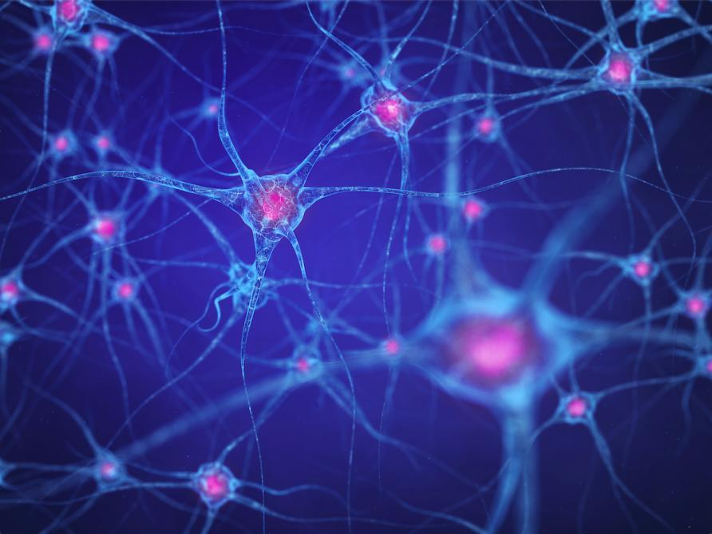
Model Architecture
CNN Architecture: Specifically created for image identification applications, the CNN model is a deep learning architecture.
Key Layers: Convolutional, pooling, and thick layers make up the model.
Feature Extraction: To extract features from input images, such as edges and forms, convolutional layers utilize filters.
Pattern Recognition: As the network goes through layers, patterns are learned, allowing the model to recognize different aspects of traffic signs.

Slide 10
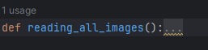
Reading the images
This function reads the all images at first. In this step first, images converted into 30x30 size from train dataset.
Then all resized image list converted into numpy arrays.
Splitting the training and test datasets by using train_test_split() function.
Converting the labels into one hot encoding.
Trained data sent to model.

Slide 11
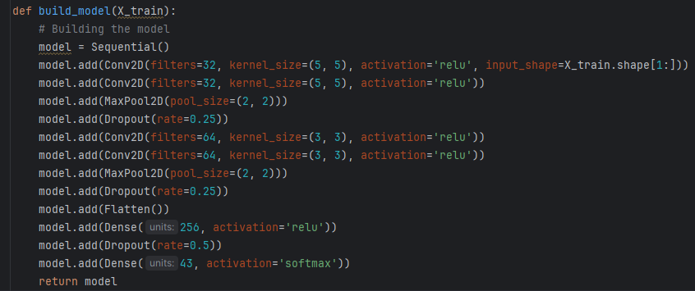
Model Understanding

Slide 12
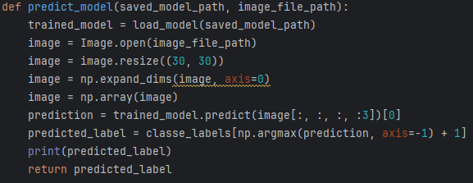
Model Understanding

Slide 13
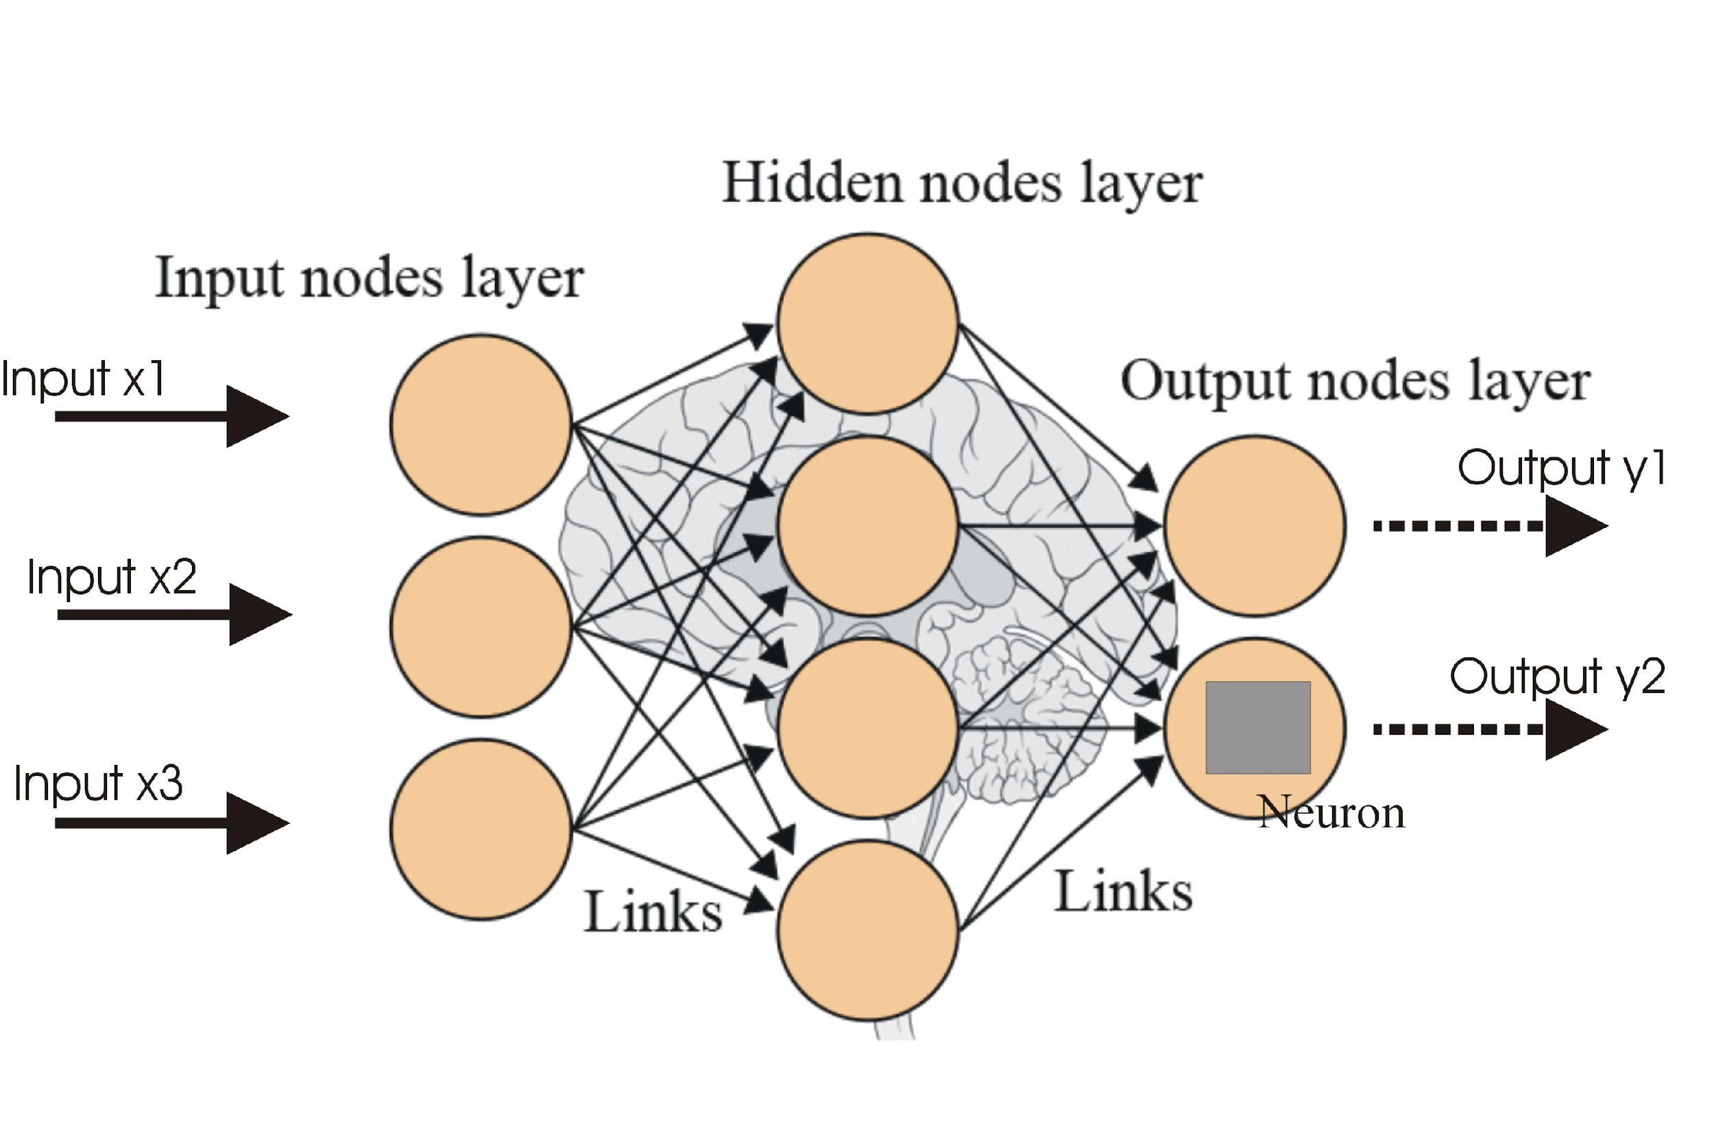
Model Training Techniques
Optimization Strategies:
The Adam optimizer is used to improve the training of our model. Adam customizes learning rates for each parameter, which leads to more rapid convergence and effective updates.
Regularization:
We use a regularization method called dropout to avoid overfitting. In order to encourage a more comprehensive model during training, dropout entails randomly deactivating a portion of neurons.
Dropout Layer Implementation:
The "Dropout" layers in the model architecture purposefully deactivate neurons at a rate of 0.25, which forces the network to use different paths in order to learn information.

Slide 14
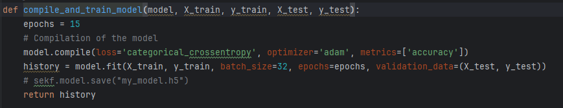
Model Training
After training the model this function is used to save the training model as training takes around 45 mins and lots of GPU and memory. We saved the trained model and use it wisely to predict the traffic signs.
The commented code is used to save model.

Slide 15
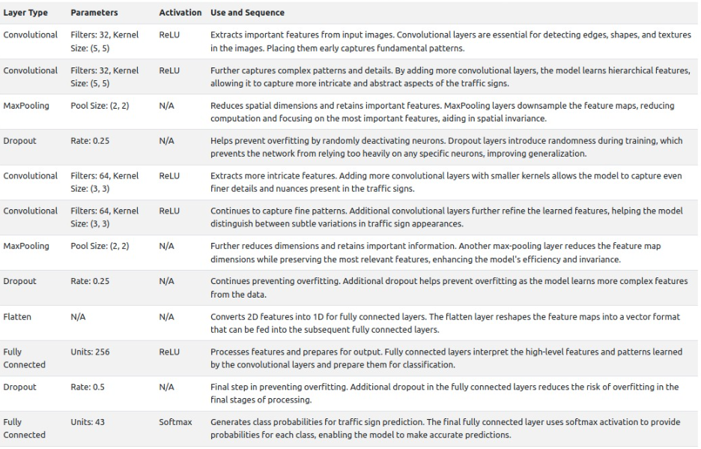

Slide 16
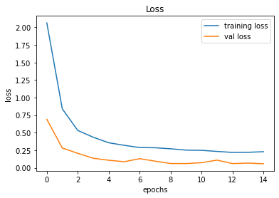
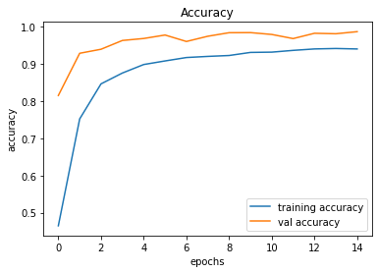
Training Insights
Visual Representations: During model training, graphs show trends in accuracy and loss over epochs.
Accuracy Curve: This shows how the model's prediction accuracy increases as it is trained.
Loss Curve: As the model gains knowledge from training data, the loss curve shows how its error falls.

Slide 17





Front-end Technology
There are vast number of technologies available for front-end development like Angular 13, React Js, Vue Js, Bootstrap, Flask, etc.

Slide 18
Why Flask?
For this project, We decided to go with flask because of several reasons mentioned below:
Flask is a lightweight and flexible web framework for Python, making it ideal for building web applications quickly and efficiently.
It provides developers with the tools to create web applications in a simple and elegant manner, allowing for rapid prototyping and development.
Flask follows the WSGI (Web Server Gateway Interface) specification and is often used with Jinja2 templating engine for dynamic HTML generation.
As aforementioned points, We decided to go with the flask and the main advantage for our project is There will not to make backend it directly deal with the models in .py file.

Slide 19
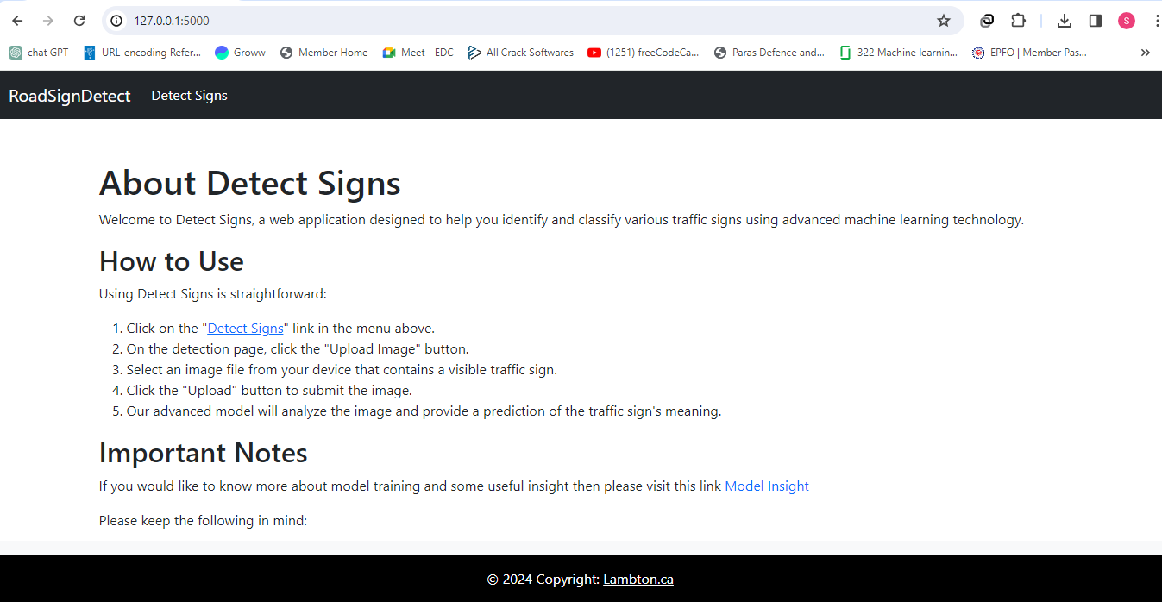
Front End Insights

Slide 20
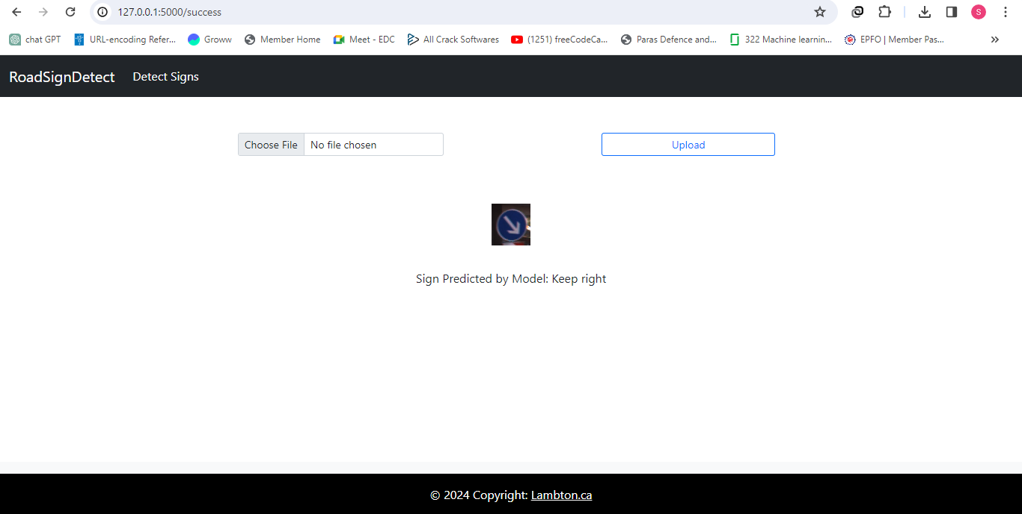
Front End Insights

Slide 21
Predicting Traffic Signs
Seamless Prediction: A traffic sign's associated label is predicted by the "predict_model" function, which accepts an image as input.
Alpha Channel Handling: Images containing transparency information, or alpha channels, are processed to preserve the RGB information while eliminating the alpha channel.
Resizing: In order to ensure compatibility with the model's input size, images are scaled to a consistent dimension before to prediction.

Slide 22
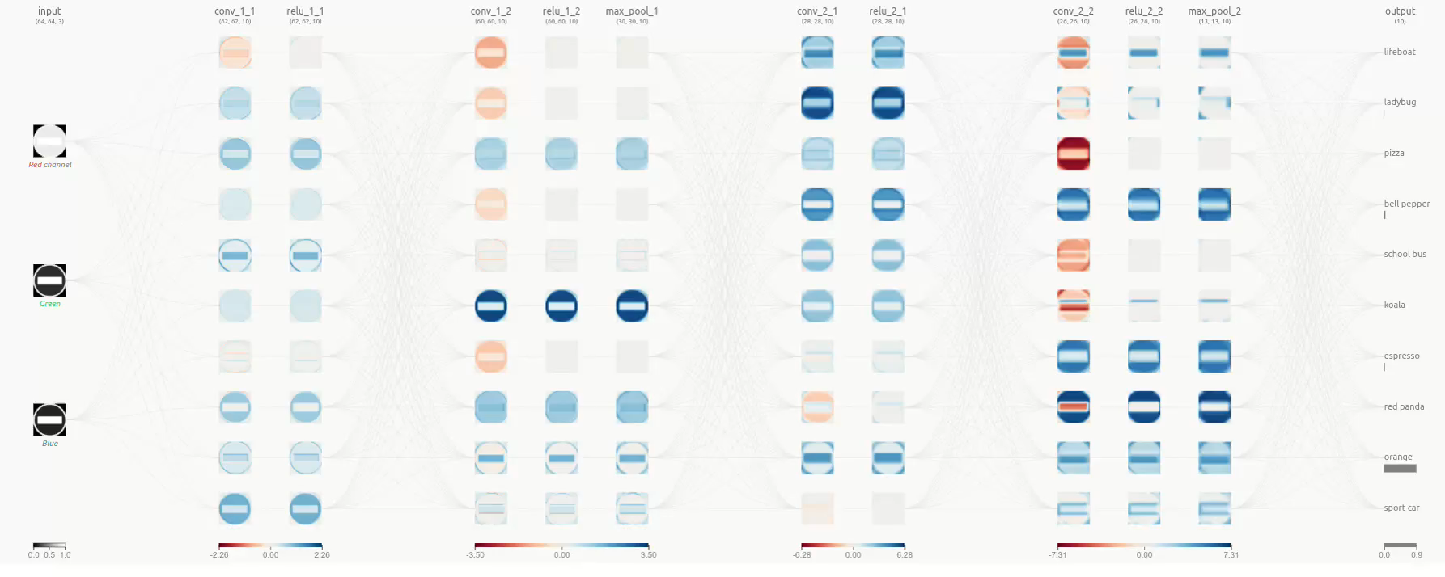

Slide 23

Future Enhancements
Innovation Roadmap: We're dedicated to ongoing development, working to increase the capabilities and experience of users.
Real-Time Capture: In the future, users may be able to utilize the camera on their device to predict traffic signs in real-time.
Batch Prediction: Simplified features can enable users to upload and forecast several pictures at once.

Slide 24
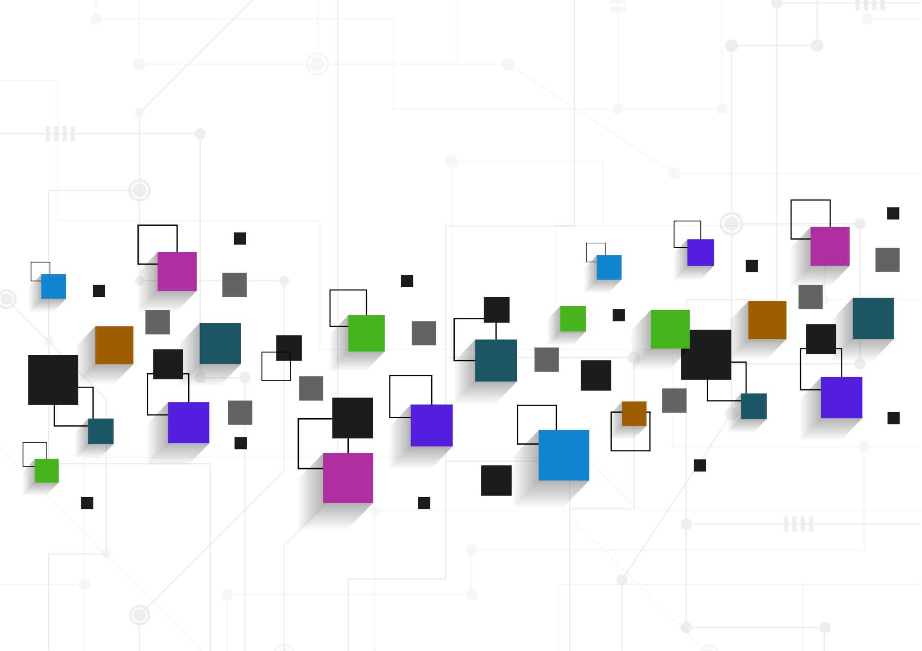
Conclusion
Finally, the Traffic Sign Recognition Web App combines safety and technology by precisely interpreting signs to encourage cautious driving. Our experience has helped to demystify machine learning and encourage research beyond forecasts.
Finally, let's not forget that the software serves as an educational portal into the field of artificial intelligence in addition to being a tool. Come celebrate with us this milestone and the app's promise to make the future safer and more informed.

Slide 25
References
● Kaggle for traffic signs classification with CNN - https://www.kaggle.com/code/valentynsichkar/traffic-signs-classification-with-cnn
● TensorFlow. (n.d.). TensorFlow Documentation. Retrieved from
https://www.tensorflow.org/
● PyTorch. (n.d.). PyTorch Documentation. Retrieved from
https://pytorch.org/docs/stable/index.html
● Sklearn. (n.d.). Scikit-learn Documentation. Retrieved from
https://scikit-learn.org/stable/documentation.html
● Github link:
https://github.com/shreyash5965/trafficsign

Slide 26


Slide 27


